Slide 1
Data Structures and Algorithms CSE 205
Lecture #0
The kick start session

Slide 2
School Vision
To be a globally recognized school through excellence in teaching, learning and research for creating Computer Science professionals, leaders and entrepreneurs of future contributing to society and industry for sustainable growth.

Slide 3
School Mission
To build computational skills through hands-on and practice-based learning with measurable outcomes.
To establish a strong connect with industry for in-demand technology driven curriculum.
To build the infrastructure for meaningful research around societal problems.
To nurture future leaders through research-infused education and lifelong learning.
To create smart and ethical professionals and entrepreneurs who are recognized globally

Slide 4
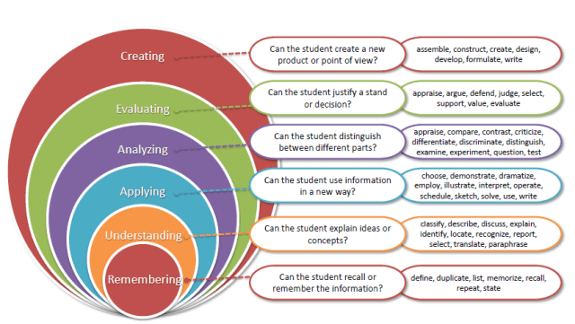
Bloom’s Taxonomy

Slide 5
Program Outcomes achieved from the course
Apply the knowledge of mathematics, science, engineering fundamentals, and an engineering specialization to the solution of complex engineering problems.
Identify, formulate, review research literature, and analyses complex engineering problems reaching substantiated conclusions using first principles of mathematics, natural sciences and engineering sciences.
Design solutions for complex engineering problems and design system components or processes that meet the specified needs with appropriate consideration for the public health and safety, and the cultural, societal, and environmental considerations.

Slide 6
Program Outcomes achieved from the course
Create, select, and apply appropriate techniques, resources, and modern engineering and IT tools including prediction and modelling to complex engineering activities with an understanding of the limitations.
Recognize the need for, and have the preparation and ability to engage in independent and lifelong learning in the broadest context of technological change.

Slide 7
Program Educational Objectives achieved from the course
Apply acquired skills in software engineering, networking, security, databases, intelligent systems, cloud computing and operating systems to adapt and deploy innovative software solutions for diverse applications.
Apply diverse IT skills to design, develop, and evaluate innovative solutions for business environments, considering risks, and utilizing interdisciplinary knowledge for efficient real-time projects benefiting society.

Slide 8
Course Details
Course Code:- CSE 205
Course Name:- Data Structure and Algorithms
LTP:- 3 0 2 [5 lectures, 2 practical's/week]
Credits:- 4

Slide 9
Why data structures?
Helps us to
get an idea of running time of algorithm
implement efficient algorithms
decide on hardware requirements
decide What is feasible vs. What is impossible
prepare job interviews

Slide 10
Course Outcomes
Understand the time and space complexity of programs and data structures.
Illustrate the importance of a Linked List in the context of real-world problems
Differentiate the Stack and Queue data structures for problem solving
Use of recursion in the iteration process and tree data structure
Apply heap operations and hashing techniques for efficient data storage, retrieval, and collision resolution.
Identify and integrating emerging data structures and algorithmic, ensuring their ability to stay with technological advancements and maintain professional growth in a dynamic field

Slide 11
Course Content
Introduction to data structures
Computation of complexity
Arrays, Sorting & Searching
Linked List
Stack and Queues
Recursions
Trees
Hashing
Graphs

Slide 12
Syllabus of CSE205
Unit I
Introduction: Basic Concepts and Notations, Complexity analysis: time, space, and trade off, Omega Notation, Theta Notation, Big O notation, Basic Data Structures.
Arrays: Linear arrays: memory representation, Array operations: traversal, insertion, deletion, sorting, searching, and merging, and their complexity analysis.
Sorting and Searching: Bubble sort, Insertion sort, Selection sort, Searching: Linear Search and Binary Search
Unit II
Linked Lists: Introduction, Memory representation, Allocation, Traversal, Insertion, Deletion, Header linked lists: Grounded and Circular, Two-way lists: operations on two-way linked lists

Slide 13
Syllabus of CSE205
Unit III
Stacks : Introduction: List and Array representations, Operations on stack (traversal, push and pop), Arithmetic expressions: polish notation, evaluation, and transformation of expressions.
Queue: Array and list representation, operations (traversal, insertion, and deletion), Priority Queues, Deques
Unit IV
Trees: Binary trees: introduction (complete and extended binary trees), memory representation (linked, sequential), Binary Search Tree: introduction, searching, insertion and deletion, In-order traversal, Pre-order traversal, Post-order traversal using recursion
Recursion: Introduction, Recursive implementation of Towers of Hanoi, Merge sort, Quick sort

Slide 14
Syllabus of CSE205
Unit V
Heaps and Hashing : Heaps: Introduction, Insertion, Deletion, HeapSort, Hashing introduction: hash functions, hash table, Open hashing (separate chaining), Closed hashing (open addressing): linear probing, quadratic probing and double hashing
Unit VI
Graphs: Graph Traversal: BFS, DFS, Shortest path algorithm: Dijkstra’s Algorithm, Bellman-Ford Algorithm, Floyd Warshall Algorithm

Slide 15
Course Assessment Model
CSE205 Marks break up*
Attendance 5
Programming Practice (Mandatory) 15
CA (One best out of Two CBTs) 15
CA Written (Mandatory) 20
ETP (Practical /Laptop) 45
Total 100
# No MTE

Slide 16
Academic Tasks
Academic Task | Tentative Week
CA-1: Programming Practice (MCQs + Coding) (Mandatory) | Week1 – Week14
CA-2: Mix of MCQs(10 Marks) + Coding Problems(20 Marks) | Week 5
CA-3: Mix of MCQs(10 Marks) + Coding Problems(20 Marks) | Week 9
CA-4: Written (Mandatory) | Week 12

Slide 17
Practice Problems
In the Practice Problems, marks are only for coding Problems.
MCQs are only for practice.
Unit-wise Sequence locking

Slide 18
Marks Calculation for Programming Practice
In order to qualify for programming practice marks, the student must solve a minimum of 50% (50% Coding Problems + 50% MCQs) problems (eligibility condition)
No marks for MCQs.
Scoring Criteria:
The students will be given approx. 132 coding problems and 90 MCQs on the selected third party platform. The questions will be framed with equal distribution from the complete syllabus. In order to qualify for programming practice marks, the student should solve at least 50% of the coding problems and 50% of MCQ questions (eligibility condition).

Slide 19
Marks Calculation for Programming Practice
The maximum marks out of 15 marks for which the student would be eligible for Programming Practice would be based on the Percentage of scored marks in the questions solved by the student.
The final marks for Programming Practice would be calculated by prorating the eligible marks for which the student is eligible (as explained in the above point) with the percentage of marks student has scored in the proctored Coding Contests conducted as CBT’s (The final marks would be round up for the students).

Slide 20
Marks Calculation for Programming Practice
Example – If a student solves 106(Correct) questions out of 132 questions (i.e. 80% questions solved) then the student would be eligible for 80% of 15 marks which is 12 marks.
And the student has scored 24 out of 30 in the CBTs i.e. 80% marks in CBTs, his Programming practice final marks would be 80% of 12 marks that he was eligible for which is 9.6 rounded up to 10 marks out of 15 for Programming Practice.

Slide 21
Daily Practice Problems
S. No | Unit | Question | Tentative Dates for Completion
1 | Unit-1 | At-least 15 Multiple Choice Questions and 22 Coding problems in each unit | 30th October 2025
2 | Unit-2 |  | 16th November 2025
3 | Unit-3 |  | 26th November 2025
4 | Unit-4 |  | 9th December 2025
5 | Unit-5 |  | 20th December 2025
6 | Unit-6 |  | 31st December 2025
Note:- Most Important for the improvement of Performance in Course Assessments.

Slide 22
End Term Practical (45 Marks)
Online Assessment on a third-party Platform
50%
# The marks scored in the online assessment will be prorated according to the viva and written marks, if the student scores less than 60% in the viva.
Components | Weightage
Mix of Coding Problems and MCQs | 30%
Written | 30%
Viva | 40%

Slide 23
Important information
Programming practice- Student will complete it unit-wise on the IamNeo platform.
All code-based tests will be conducted on the IamNeo platform.
ETP will be conducted on the IamNeo platform.
URL: https://lpucolab438.examly.io/login
User Name: RegistrationNumber@neocolab.ai
Password: Registration Number

Slide 24
Why Star Course?
Weightage in Gate/Govt. exams
Industry demand
Product-Based
Service Based
Higher Studies
Government Jobs

Slide 25
Skillset
Programming Skills
Logic building
Code analysis

Slide 26
MOOCs
Not Applicable

Slide 27
Recognition of Prior Learning (RPL) (Under EduRev)
The course “Data Structure and Algorithms" is included under the Recognition of Prior Learning (RPL) scheme offered by EduRev.

Slide 28
How RPL is Applicable
Under the EduRev RPL Framework, the following process is followed:
1. Eligibility for RPL
Learners who believe they already possess the skills and knowledge covered in the Data Structures and Algorithms course may apply for RPL within the specified timelines.
2. Assessment Process
Once the RPL application is accepted, the student will be required to appear for an RPL assessment/examination. This assessment is designed to evaluate the learner’s knowledge of Data Structures and Algorithms.
3. Performance-Based Exemption
If the student has successfully completed the NPTEL course, then the Marks of only 1 CA(Written CA) will be prorated based on the student's performance in the NPTEL course.

Slide 29
Interfaces and Contact Information
UMS link to apply for EDU Revolution initiatives:
UMS Navigation --- LMS → EDU Revolution: BE THE CHANGE
In case of any query in this regard, the student can approach for resolution through RMS at the following path:
UMS Navigation--- Relationship management system → EDU Revolution: BE THE CHANGE
OR get your queries resolved through the Helpline Number: 01824-520150.

Slide 30
Open Education Resources (OER)
Unit mapped | Broad topic | Sub Topic | Source Type | Source Title | *%age mapping (approx) | Source URL
Unit 1 | Arrays, Sorting and Searching | Array operations: traversal, insertion, deletion, sorting, searching | Reading material (online tutorial), Practice Questions | Learn Data Structures and Algorithms |DSA Tutorial | 70% | https://www.geeksforgeeks.org/array-data-structure/?ref=lbp
Unit 2 | Linked Lists | Introduction, Memory representation, Allocation, Traversal, Insertion, Deletion, | Reading material (online tutorial), Practice Questions | Learn Data Structures and Algorithms |DSA Tutorial | 80% | https://www.geeksforgeeks.org/data-structures/linked-list/?ref=lbp

Slide 31
Open Education Resources (OER)
Unit 3 | Stacks, Queue | Introduction: List and Array representations, Operations on stack (traversal, push and pop) | Reading material (online tutorial), Practice Questions | Learn Data Structures and Algorithms |DSA Tutorial | 60% | https://www.geeksforgeeks.org/stack-data-structure/?ref=lbp
Unit 4 | Trees, Recursion | Binary trees: introduction, searching, insertion and deletion, In-order traversal, Pre-order traversal, Post-order traversal using recursion | Reading material (online tutorial), Practice Questions | Learn Data Structures and Algorithms |DSA Tutorial | 70% | https://www.geeksforgeeks.org/introduction-to-tree-data-structure-and-algorithm-tutorials/?ref=lbp

Slide 32
Open Education Resources (OER)
Unit 5 | Heaps and Hashing | Heaps: Introduction, Insertion, Deletion, HeapSort, Hashing introduction: hash functions, hash table, Open hashing (separate chaining), Closed hashing (open addressing): linear probing, quadratic probing and double hashing | Reading material (online tutorial), Practice Questions | Learn Data Structures and Algorithms |DSA Tutorial | 50% | https://www.geeksforgeeks.org/dsa/hashing-data-structure/
Unit 6 | Graphs | Graph Traversal: BFS, DFS, Shortest path algorithm: Dijkstra’s Algorithm, Bellman-Ford Algorithm, Floyd Warshall Algorithm | Reading material (online tutorial), Practice Questions | Learn Data Structures and Algorithms |DSA Tutorial | 60% | https://www.geeksforgeeks.org/graph-data-structure-and-algorithms/?ref=lbp

Slide 33
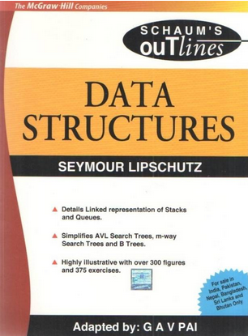
Text/Reference books
Books to Follow
Data Structures (Schaum’s Outlines Series) Author - Seymour Lipschutz
Data Structures And Algorithms
By Alfred V. Aho, Jeffrey D. Ullman
And John E. Hopcroft, Pearson

Slide 34




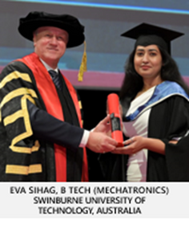
Division of International Affairs, LPU
Semester Exchange at LPU
LPU’s International Credit Transfer
Summer/Winter School Program
LPU’s Semester Exchange Program allows students to study abroad for one semester at a partner institution.
The LPU International Credit Transfer Program allows students to begin their studies at LPU and seamlessly transfer to complete their degree at a foreign partner university
This program allows to spend 2-4 weeks for cultural exposure at partner university
100% Scholarship
(On overseas Tuition Fees)
(Applicable in most cases)
Apply During
Feb/Aug
Bachelor’s Degree
2+2
Master’s Degree
1+1
Duration
One Semester
Eligibility
6 CGPA
(No reappear/backlog)
1st & 2nd Year at LPU
1st Year at LPU
Final Degree
From LPU
Avg. Budget
2.5 to 5 Lakh INR
(Living & Travel Experience)
3rd & 4th Year at Foreign University
2nd Year at Foreign University
Final Degree from the Foreign Partner University
MBA students went to Chungnam National University, south korea for winter school program

Slide 35
Academic Mobility in CSE – Explore the World
Semester Exchange Program (100+ Partners)
International Credit Transfer Program (20+ Partners)
Murray State University, Kentucky, USA
Rowan University, New Jersey, USA
SUNY Oswego, New York , USA
University of South Carolina Aiken, USA
Tiffin University, Ohio, USA
Trent University, Peterborough, Canada
University of Lethbridge, Alberta, Canada
Aivancity School for Technology Business & Society, Cachan, France
Deakin University, Melbourne, Australia
Swinburne University of Technology, Australia
Victoria University of Wellington, New Zealand
University of Waikato, New Zealand
University of Plymouth, England,UK
Manchester Metropolitan University, Manchester,UK
University of Huddersfield,UK
Heriot-Watt University Scotland,UK
University of Strathclyde, Scotland,UK
Solent University, Southampton, UK
Staffordshire University, UK
Glasgow Caledonian University, Scotland, UK
University of Klagenfurt, Austria
Memorial University of Newfoundland, Canada
University of Lethbridge, Canada
LeTourneau University, USA
Livingstone College, USA
University of Wisconsin–Madison, USA
Curtin University, Australia
University of Nantes, France
Telkom University, Indonesia
University of Chieti-Pescara, Italy
Riga Technical University, Latvia
Vilnius University, Lithuania
University of Łódź, Poland
Southern Federal University, Russia
Woosong University, South Korea
Universidad de Jaén, Spain
Saint Petersburg Electrotechnical University "LETI", Russia

Slide 36


Want to go global? Scan to explore more!
INTERNATIONAL CREDIT TRANSFER PROGRAM ENQUIRY FORM
SEMESTER EXCHANGE PROGRAM ENQUIRY FORM
FOR MORE DETAILS, VISIT BLOCK 32-310, Division of International Affairs

Slide 37
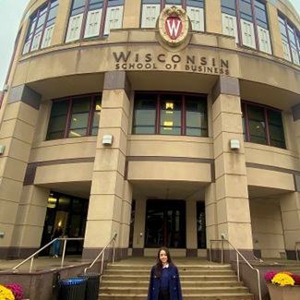
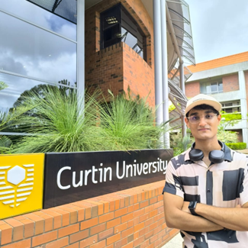


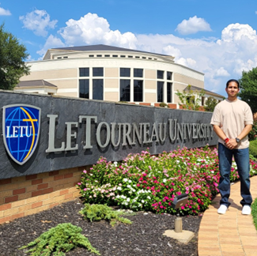

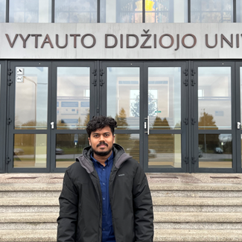



Your Seniors Went Global—Are You Next?

Slide 38

Zero Lecture Feedback
Visit URL: https://forms.gle/PQGdQNGQ3yK2B2kt6

Slide 39
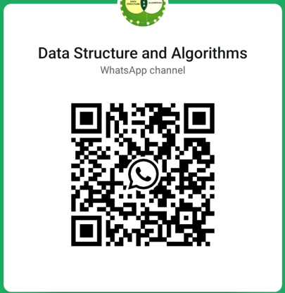
Data Structures and Algorithms (Information given by Coordinators)
https://whatsapp.com/channel/0029Vb5q597KgsNm5fQwU01y
(Everyone must join the group)

Slide 40

Next Class: Basic Data Structures

